Slide 1

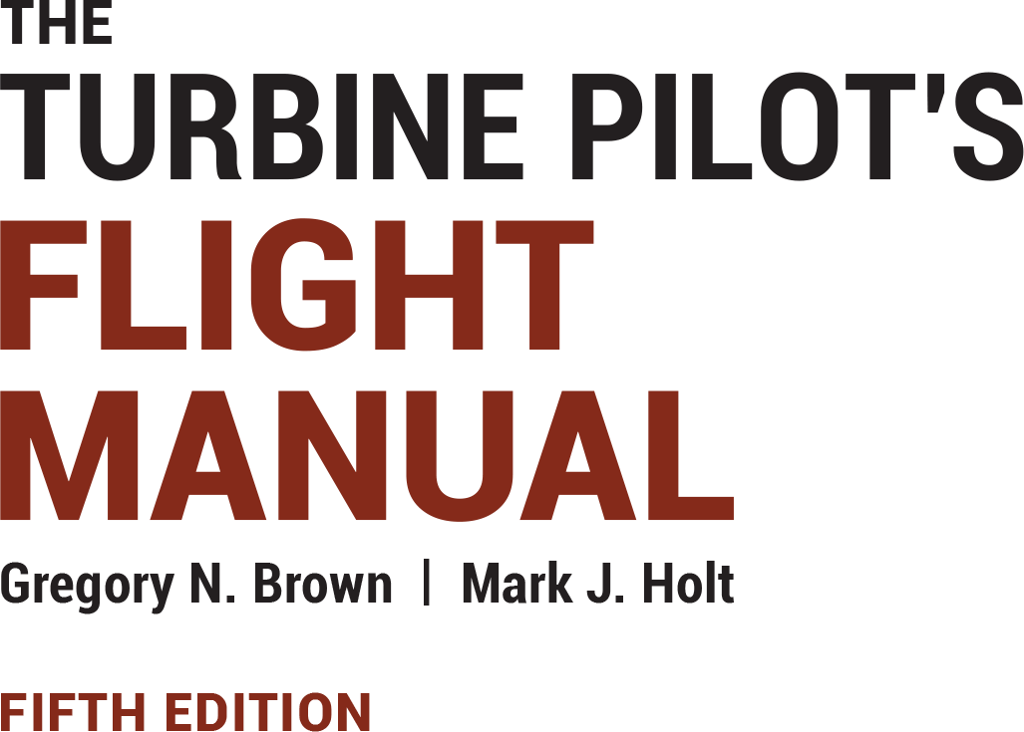
Instructor Resources
Chapter 9 Figures
Cover photo: BeautyStock – stock.adobe.com.

Slide 2
Chapter 9
Emergency and Abnormal Procedures

Slide 3
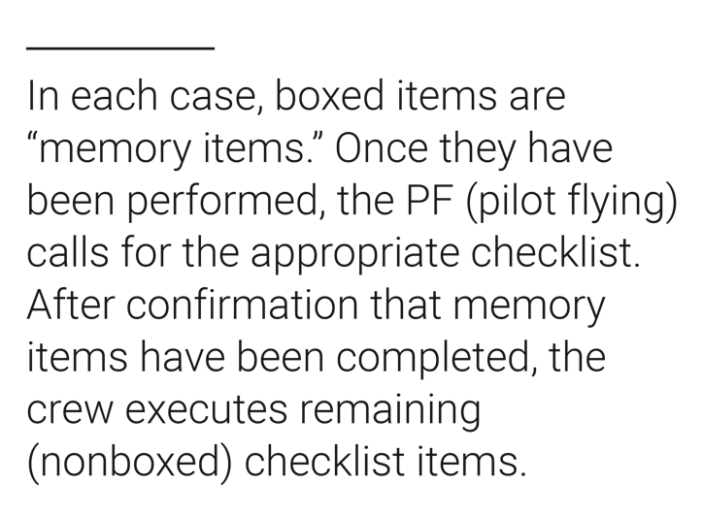
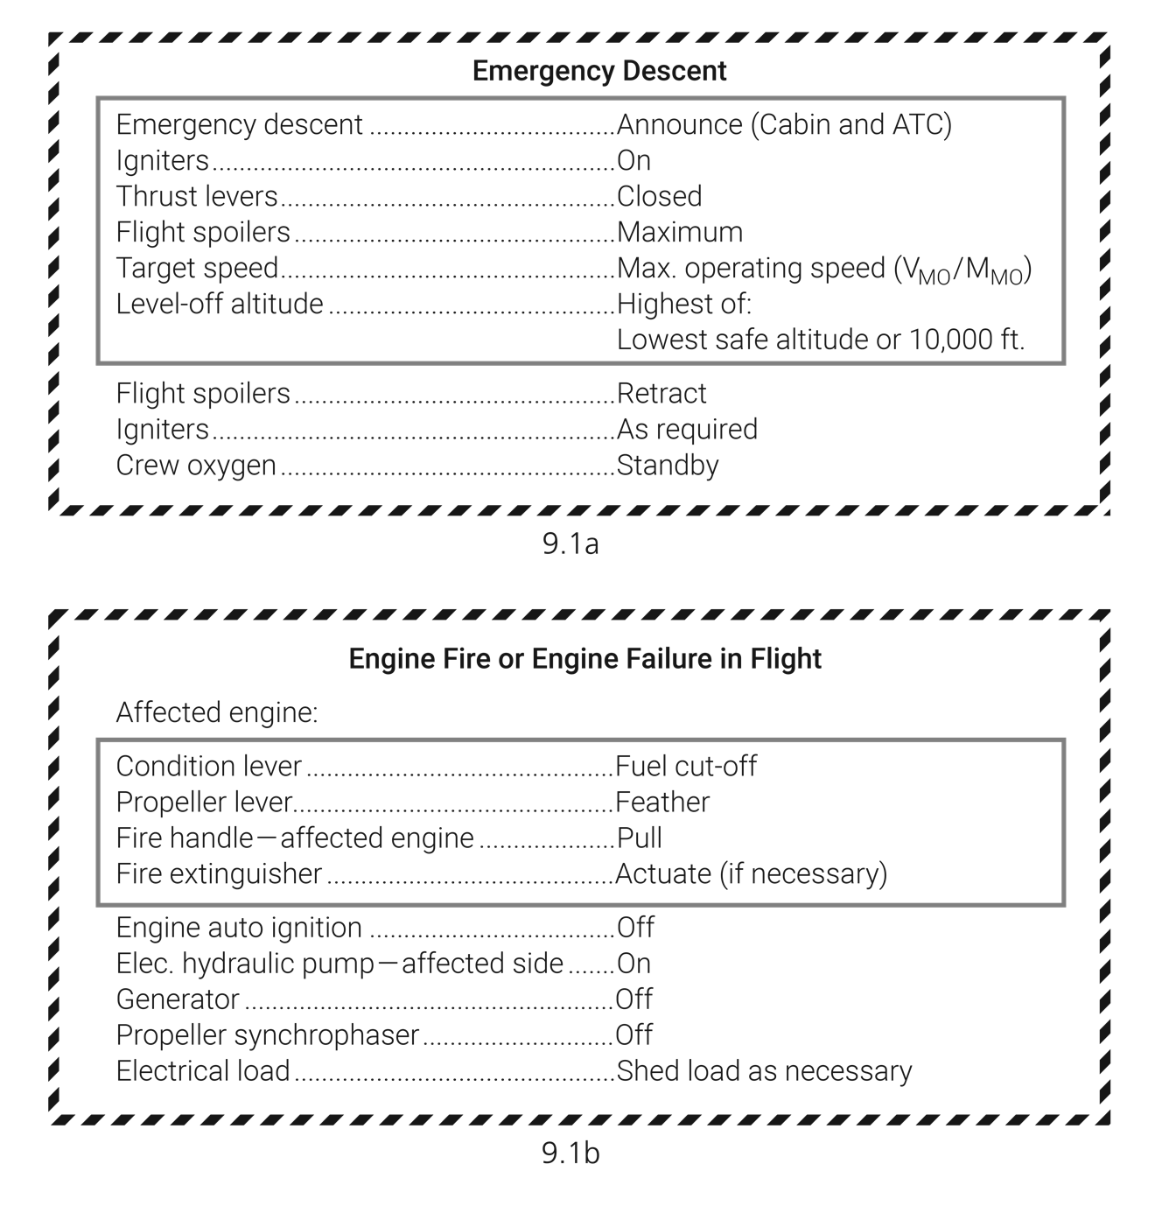
9.1a
9.1b
FIGURE 9.1
Typical emergency checklists.

Slide 4
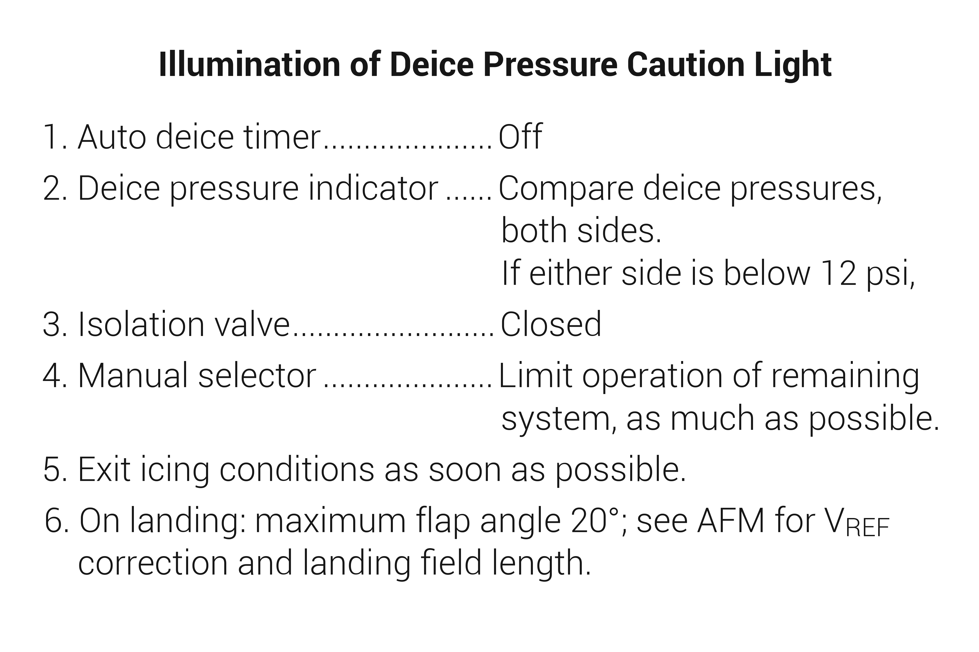
FIGURE 9.2
Typical abnormal checklist (nonemergency).

Slide 5
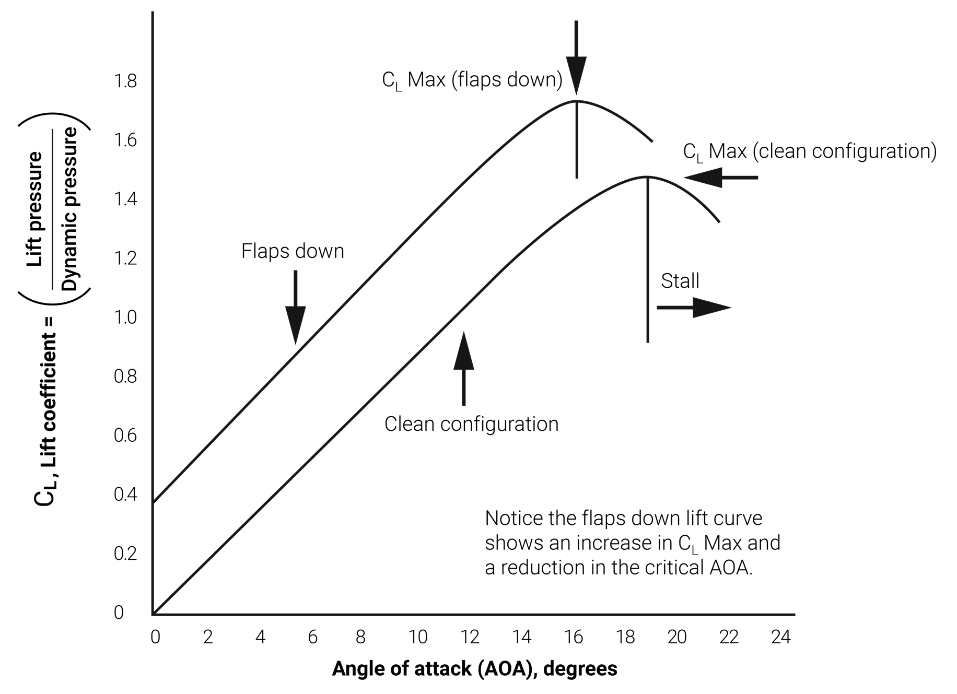
FIGURE 9.3
Coefficient of lift curve.

Slide 6
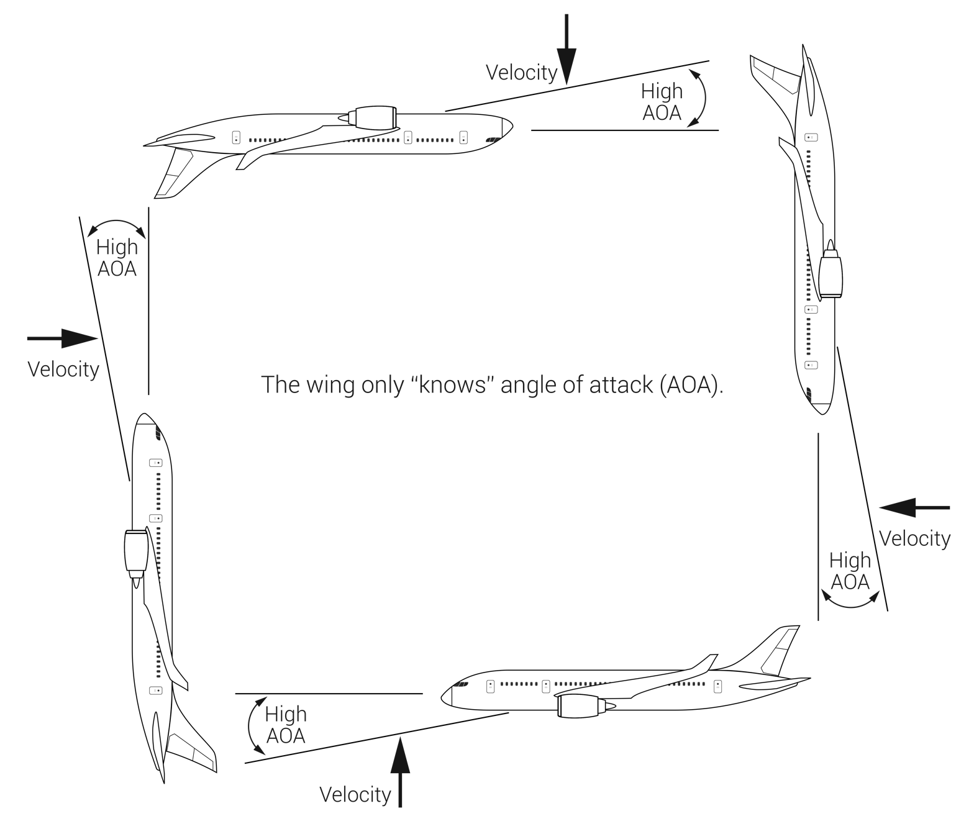
FIGURE 9.4
An aircraft can be stalled at any attitude or airspeed.

Slide 7
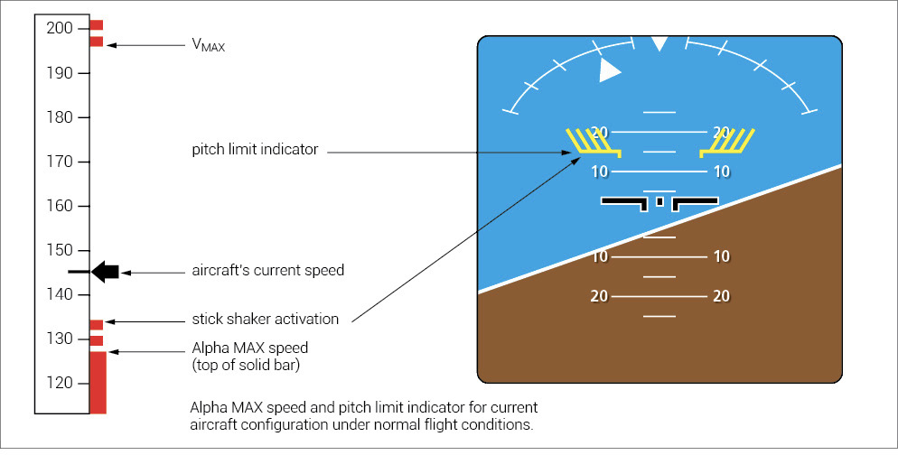
FIGURE 9.5
Primary flight display (PFD) showing “alpha max” speed and pitch limit indicator.

Slide 8
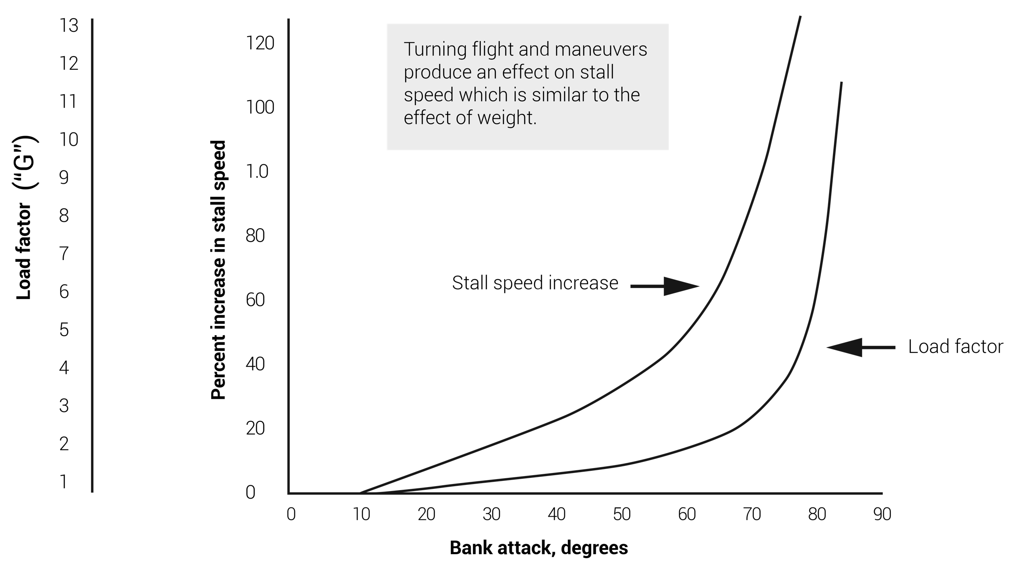
FIGURE 9.6
Effect of bank angle on stall speed.

Slide 9
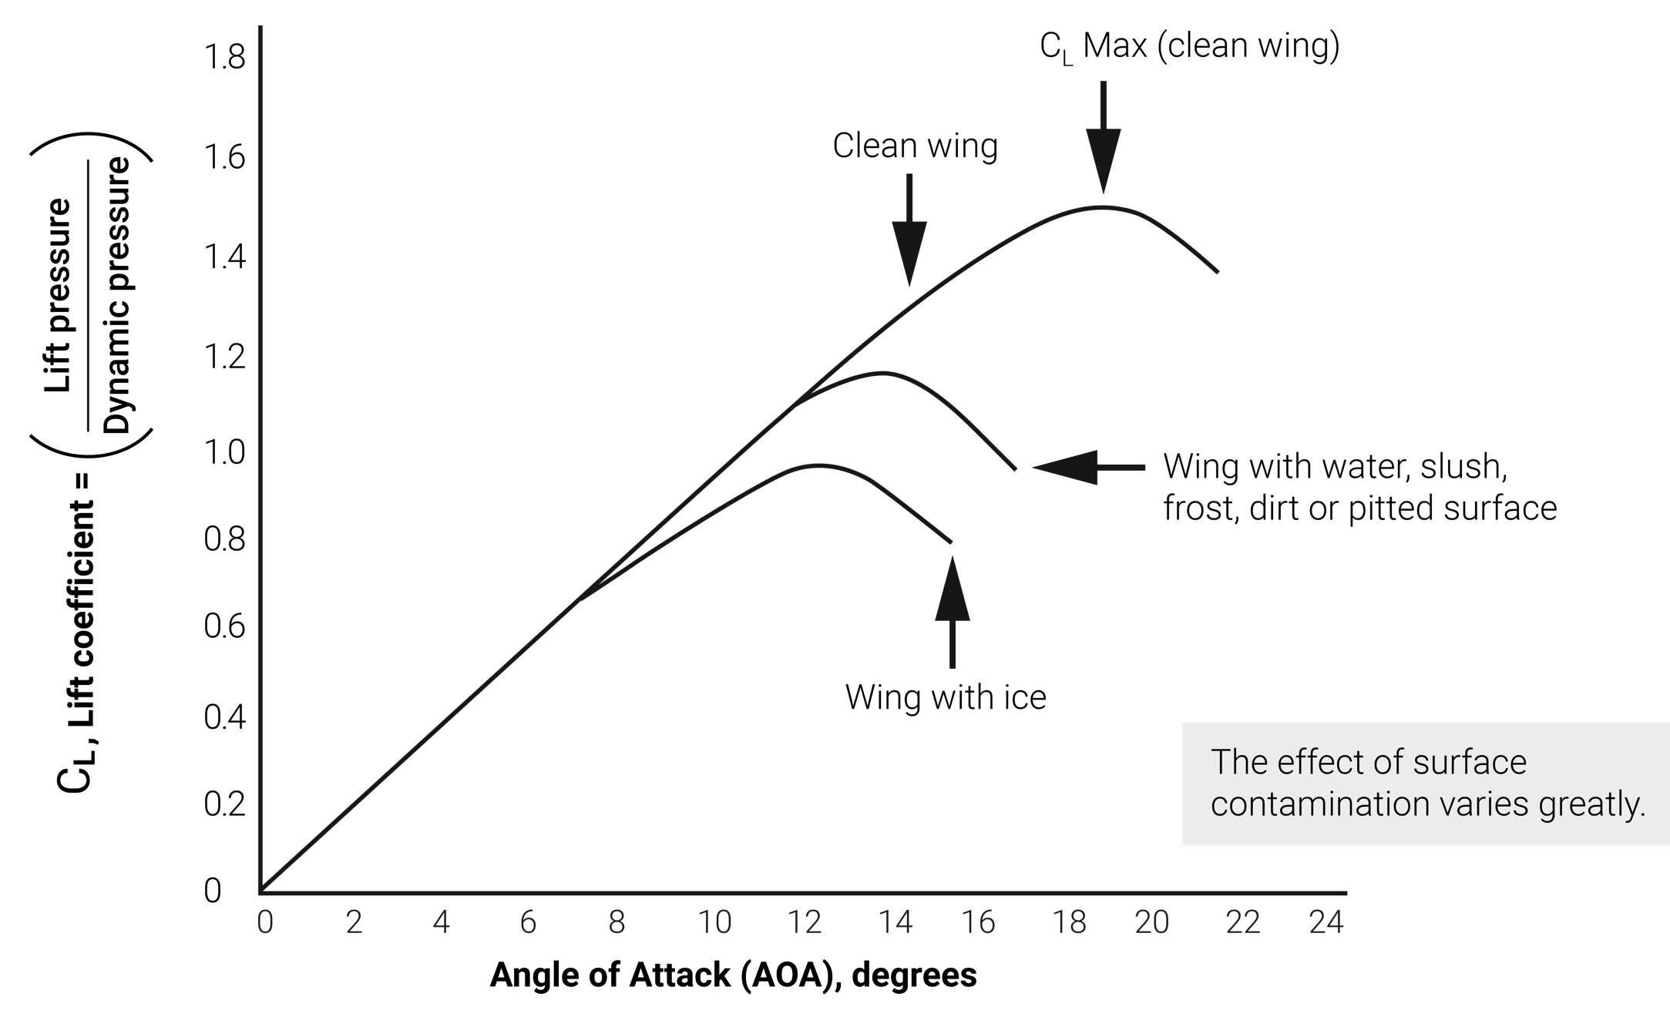
FIGURE 9.7
The effect of surface contamination on lift.

Slide 10
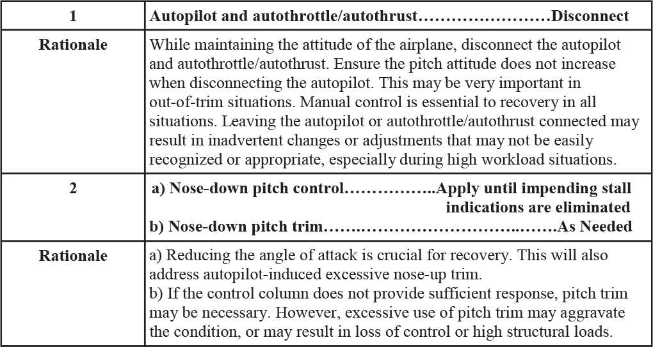
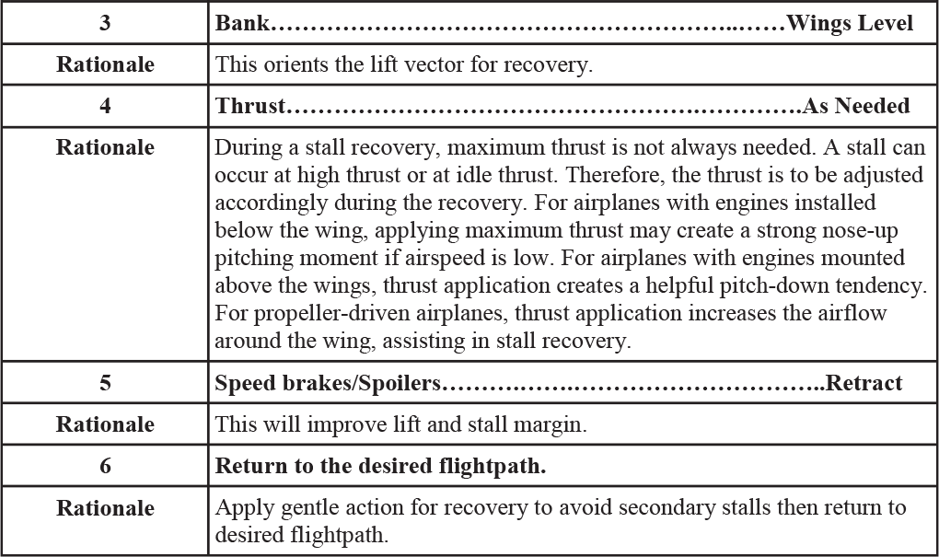
(continued)
FIGURE 9.8
Stall Recovery Template (from FAA AC 120-109A, Appendix 1, Table 1).

Slide 11
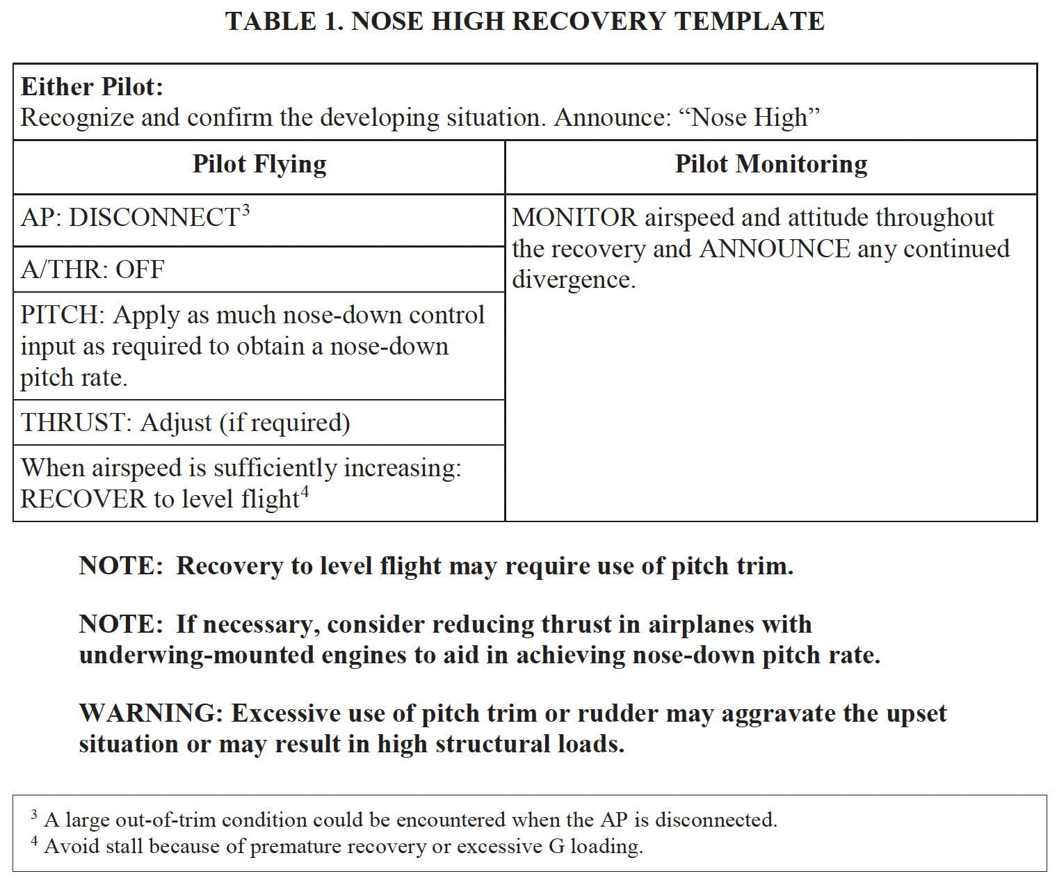
FIGURE 9.9
Nose high recovery template (UPRT) (from FAA AC 120-111).

Slide 12
FIGURE 9.10
Nose low recovery template (UPRT) (from FAA AC 120-111).

